Slide 1
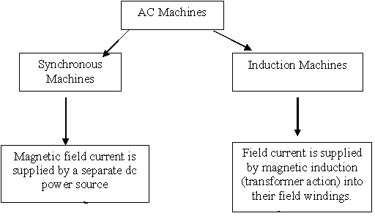
AC Machinery Fundamentals

Slide 2
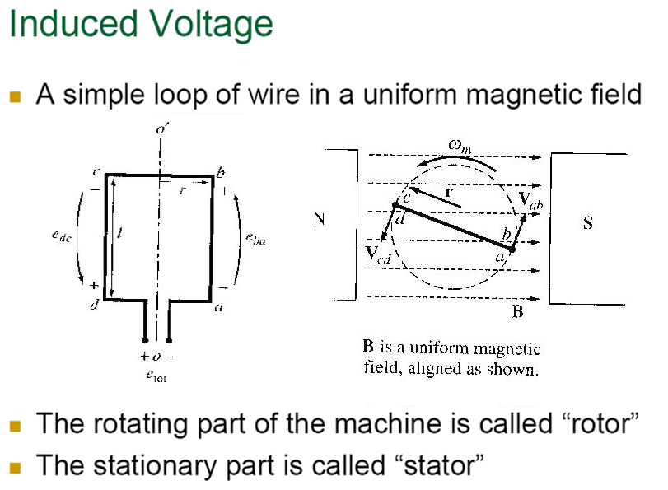
AC Machinery Fundamentals

Slide 3
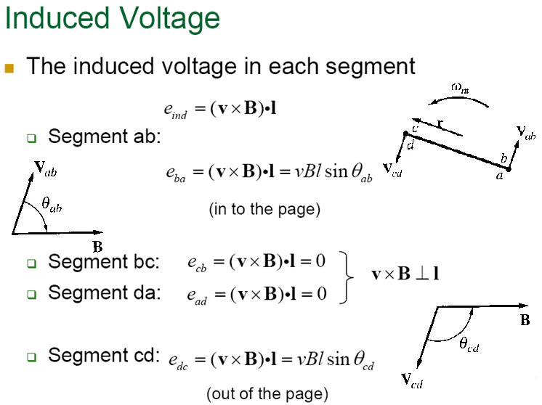
AC Machinery Fundamentals

Slide 4
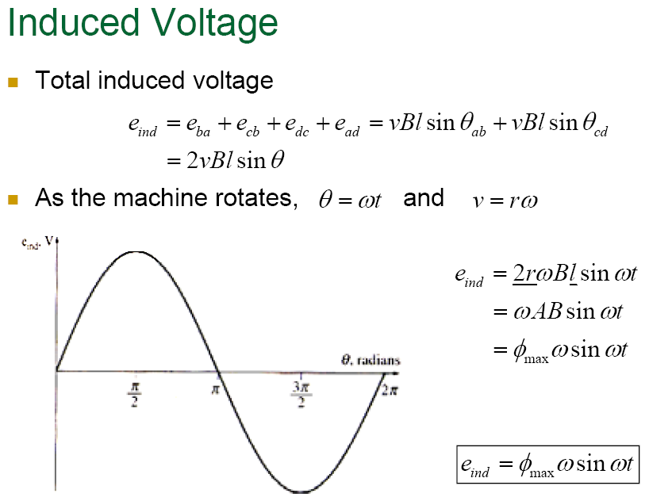
AC Machinery Fundamentals

Slide 5
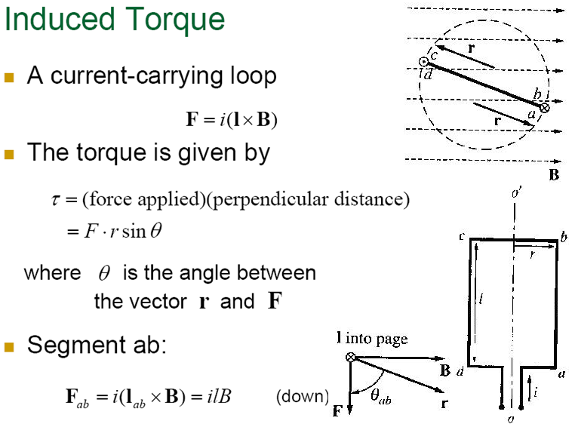
AC Machinery Fundamentals

Slide 6
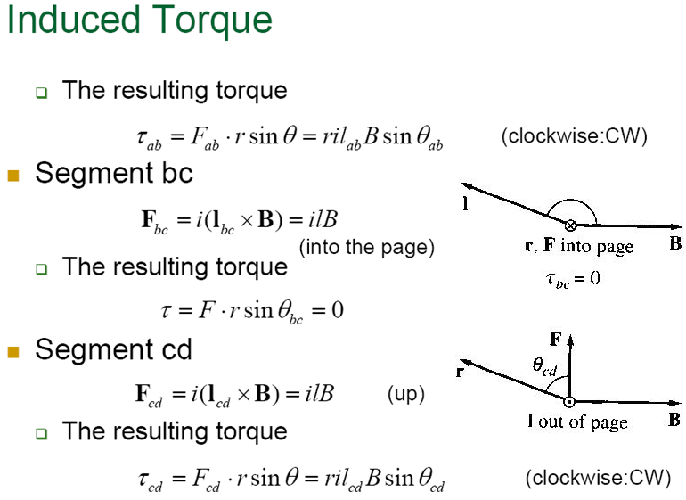
AC Machinery Fundamentals

Slide 7
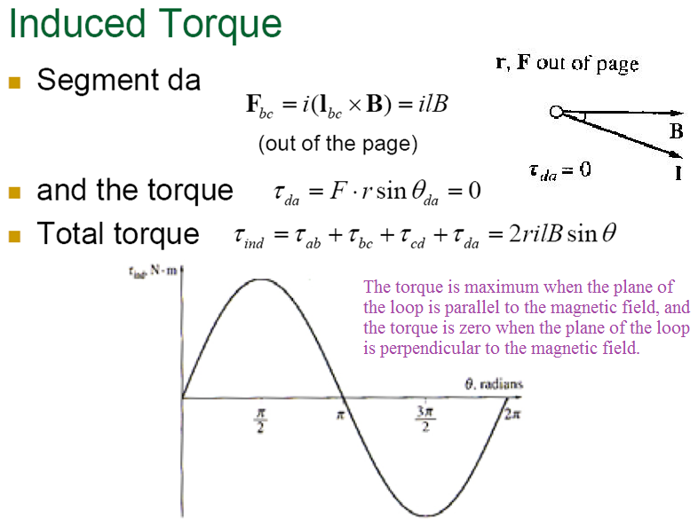
AC Machinery Fundamentals

Slide 8
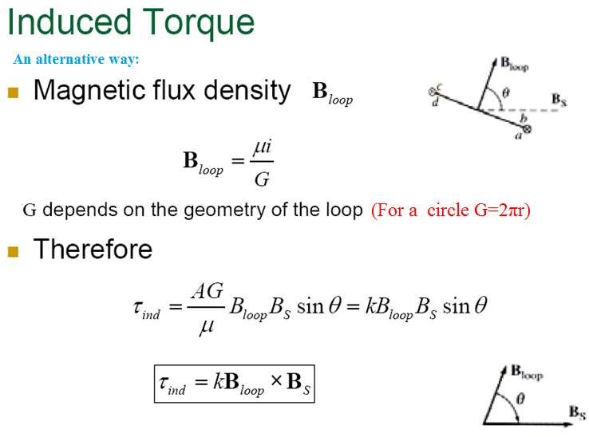
AC Machinery Fundamentals

Slide 9
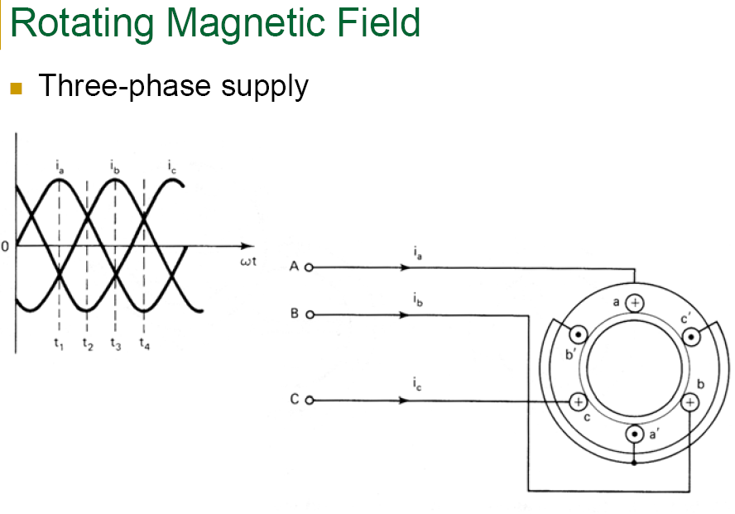
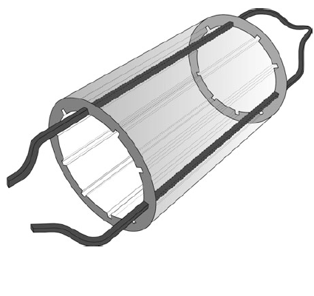
AC Machinery Fundamentals

Slide 10
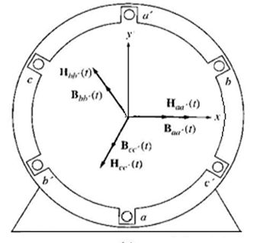
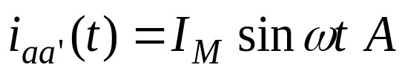
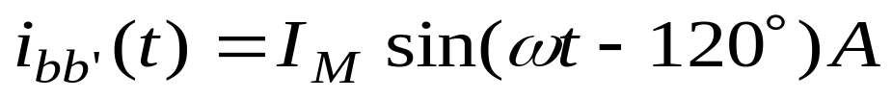
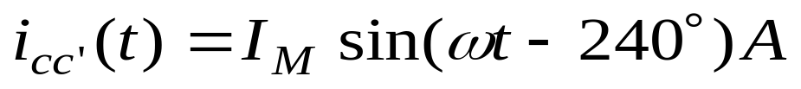
AC Machinery Fundamentals
The Rotating Magnetic Field

Slide 11
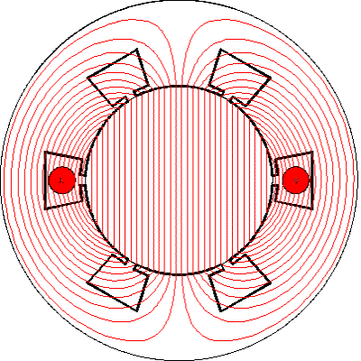
AC Machinery Fundamentals
Magnetic Field of one phase

Slide 12
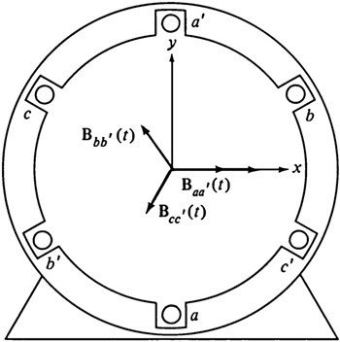



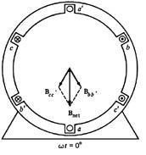


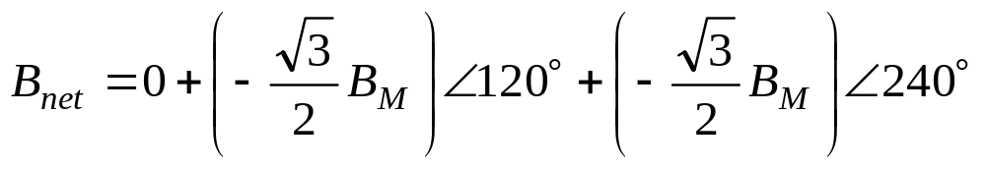

AC Machinery Fundamentals
The Rotating Magnetic Field
At time

Slide 13

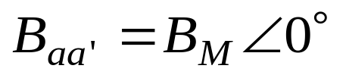
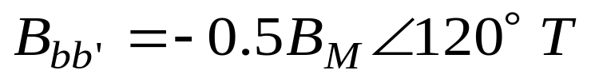
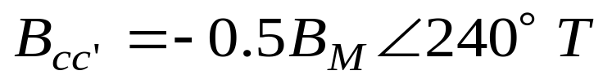
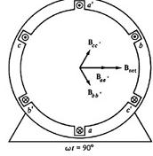

AC Machinery Fundamentals
The Rotating Magnetic Field
At time

Slide 14
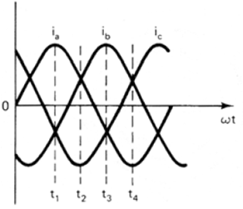
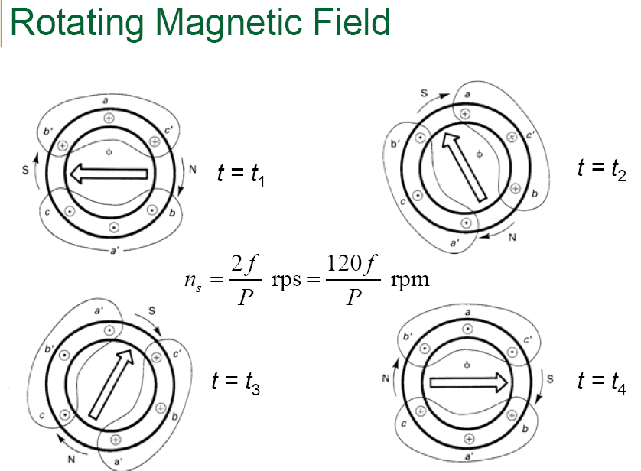
AC Machinery Fundamentals

Slide 15
AC Machinery Fundamentals
The Rotating Magnetic Field
At any time t, the magnetic field will have the same magnitude 1.5 BM and it will continue to rotate at angular velocity ω.
Bnet = Baa’ + Bbb’ +Bcc’

Slide 16
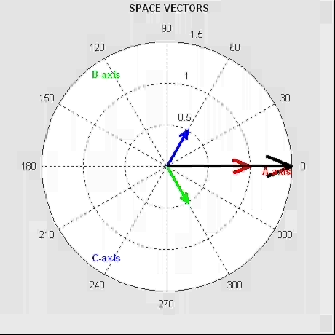
AC Machinery Fundamentals
The Rotating Magnetic Field

Slide 17
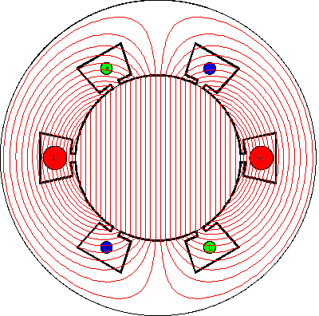
AC Machinery Fundamentals
The Rotating Magnetic Field

Slide 18
AC Machinery Fundamentals
The Rotating Magnetic Field
If the current in any two of the 3 coils is swapped, the direction of the magnetic field’s rotation will be reversed .
Bnet = Baa’ + Bbb’ +Bcc’

Slide 19
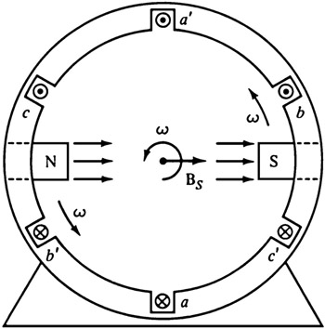
AC Machinery Fundamentals
Multi-pole winding
The rotating magnetic field in this stator can be represented as a north pole (the flux leaves the stator) and a south pole ( flux enters the stator).
These magnetic poles complete one mechanical rotation around the stator surface for each electrical cycle of the applied current. The mechanical speed of rotation of the magnetic field in revolutions per second is equal to electric frequency in hertz
ω_{e} = ω_{m} ; two pole winding

Slide 20
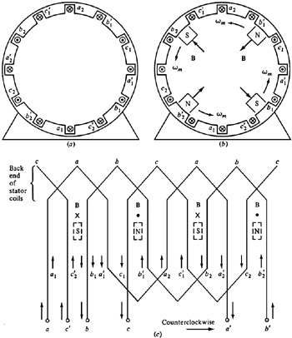
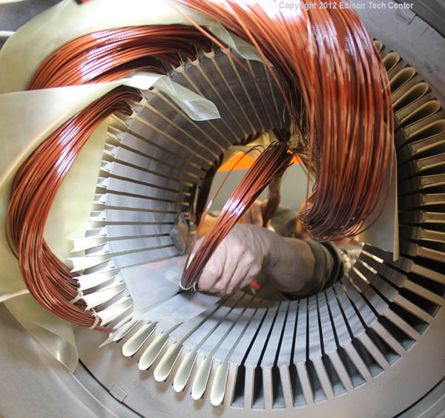
AC Machinery Fundamentals
Multi-pole winding

Slide 21
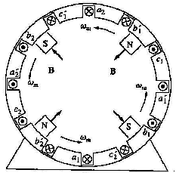
AC Machinery Fundamentals
Multi-pole winding
If we were to double the amount of windings, the stator will have 2 north poles and 2 south poles produced in the stator winding. So it is called a four-pole winding. In this winding, a pole moves only halfway around the stator surface in one electrical cycle. Notice that there are moving poles of alternating polarity every 90° around the stator surface.
Since one electrical cycle is 360 electrical degrees, and mechanical motion is 180 mechanical degrees, the relationship between the electrical angle θe and the mechanical θm in this stator is
ω_{e} = 2ω_{m} ; four pole winding

Slide 22
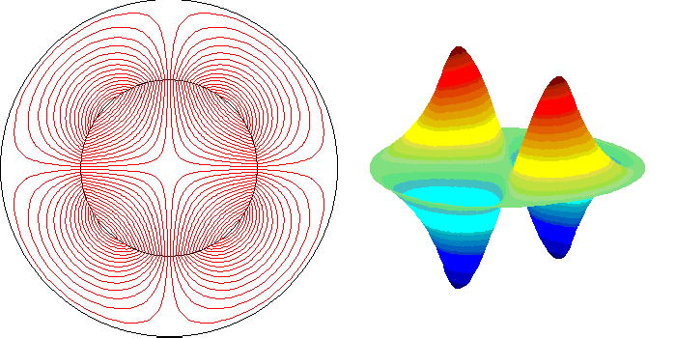
AC Machinery Fundamentals
Multi-pole winding
ω_{e} = 2ω_{m} ; four pole winding

Slide 23
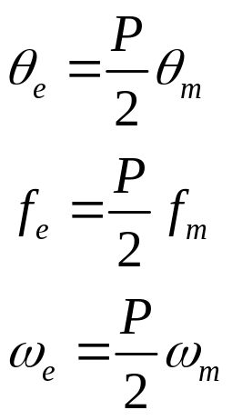
AC Machinery Fundamentals
Multi-pole winding
Therefore the general format for a P-pole winding will be as follows:

